Slide 1
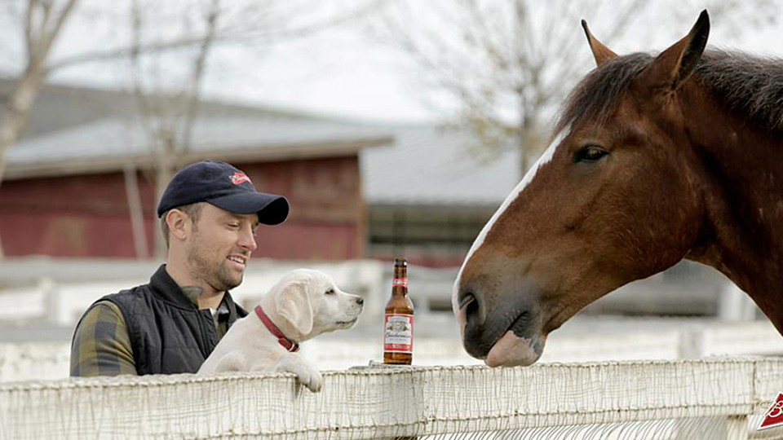
Anheuser-Busch Beer Report 2019 Beer and Brewery Spotlight
Phillip Hale
For additional details on the dataset and findings refer https://github.com/naivelogic/MSDS-6306-Case-Study-01-Budweiser
Notes:
Welcome to the Anh-Bush Beer Report. I want to give a big thank you to the Anh-Bush exce team and the Budwis subsidiary for the opportunity to collaborate and present our findings in this years 2019 Beer and Brewery Spotlight
The link below provides additional details, analysis and reproducable results that will be presented

Slide 2
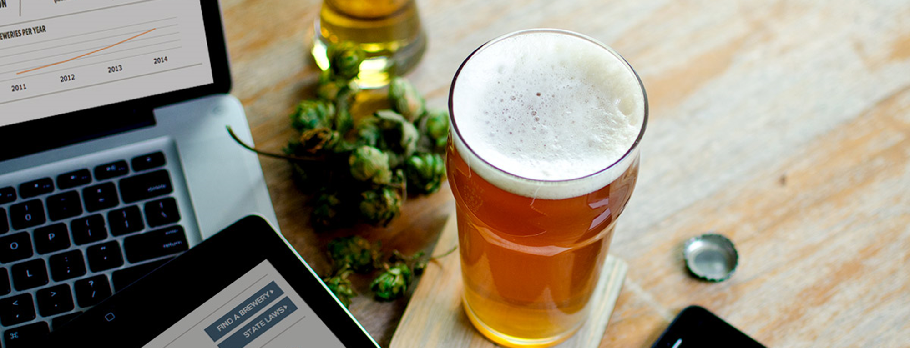
Objective: Assess the relationship of ABV and IBU
Reviewed over
2,000
Types of Beers
Produced
in
558
Breweries
across
51
States + Washington DC
Notes:
Overall objective is to assess the relationship of alcohol by volume of the beer (ABV) and the Internaltiona Bitterness Units of the beer (IBU) for the data that was provided.

Slide 3
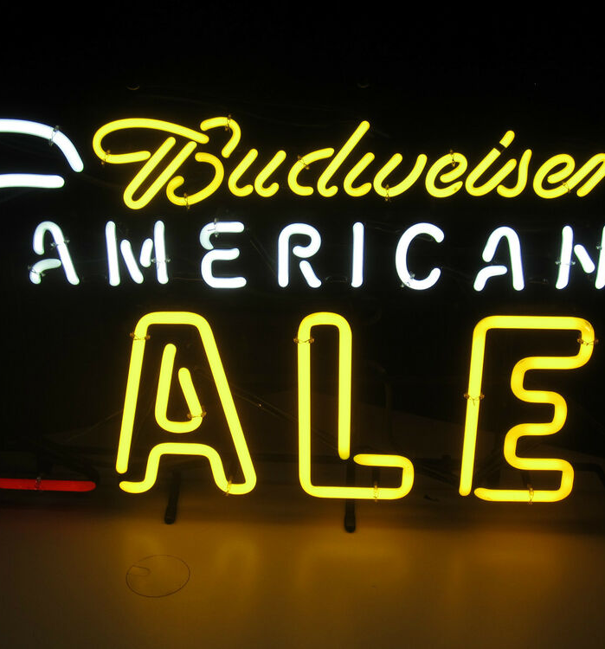

AMERICAN IPA MOST PRODUCED BEER STYLE...
Top 5 beer styles produced in the United States
Notes:
America IPA is the most produced Beer style. Below you can see the top 5 beer stlyes produced in the Unitied States. American IPA represents just under 18% of all styles produced.

Slide 4
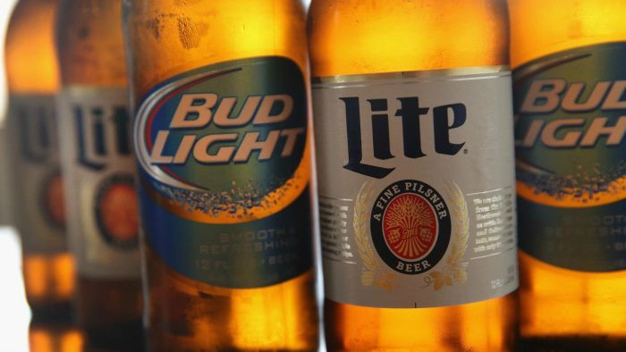
HANDLING MISSING VALUES
3%
ABV Values Missing
43%
IBU Values Missing
South Dakota
Removed From IBU Analysis
Notes:
Before we jump into the analysis on how ABV relates to IBU – we want to make a quick note on how we handled missing values.
3% of ABV of beer contained missing values; and
43% of IBU of beer contained missing values.
All missing values were removed during the following analysis, as they related there measuring category,
For example, South Dakota was removed for the IBU beer analysis bc all values were missing

Slide 5
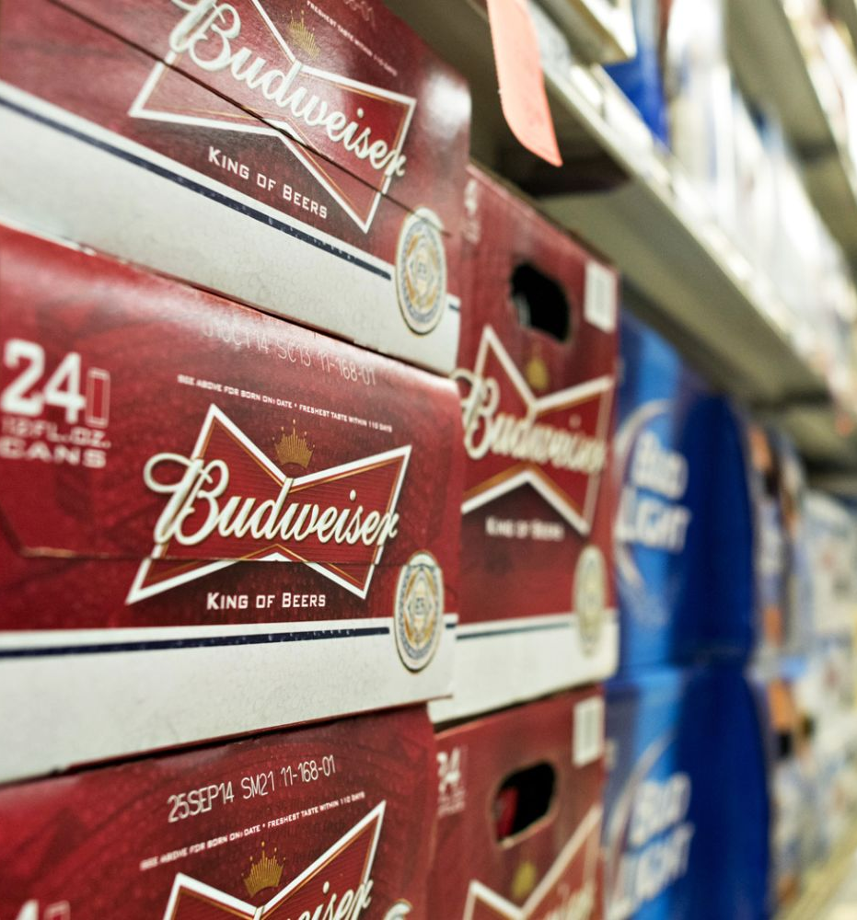
DC & Kentucky PRODUCES THE HIGHEST ABV (ON AVERAGE)...
Top 5 states with this highest median ABV
Refer to appendix for full Median ABV by State Graph
Notes:
We found that Washington DC and Kentucky both produced the highest alcohol by volume of beer when taking the median value of all AVB by state. For both DC and Kentucky the ABV median value was 0.063. As you can see in the below graph this is in close proximity to the top 5 median state ABV beer in productoin. Please see appendix for full Median ABV by State Graph
Image from https://fm.cnbc.com/applications/cnbc.com/resources/img/editorial/2014/10/30/102138680-458104168.1910x1000.jpg

Slide 6
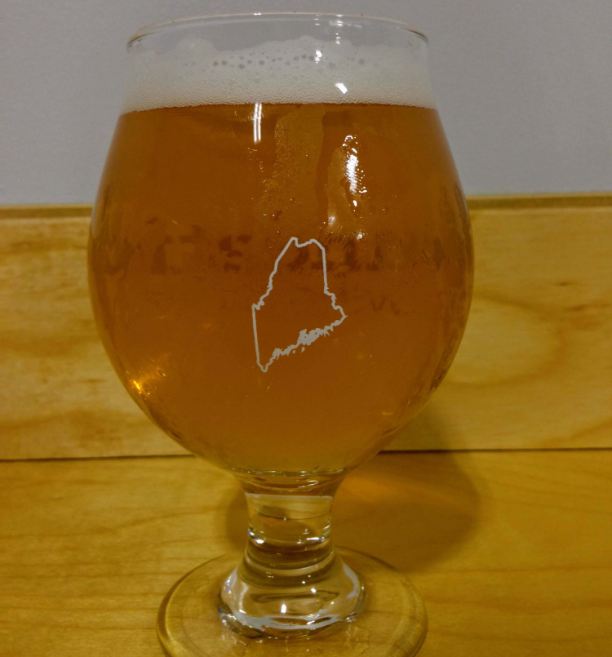
MAINE PRODUCED THE HIGHEST IBU (ON AVERAGE)...
Top 5 states with this highest median IBU
Refer to appendix for full Median IBU by State Graph
Notes:
We found that Maine with a median international bitterness units of beer of 61 which was the produced the highest IBU when taking the median value of all IBU by state. As you can see in the below graph this is there is a larger difference in IBU median by state in contrast to Alcohol by volume of beer.
Please see appendix for full Median IBU by State Graph

Slide 7
...but our opportunity lies In The West.
Median ABV
Median IBU
Refer to appendix for full Median IBU by State Graph
Notes:
Taking the same median dataset and comparing alcohol by volume and international bitterness units of beer, respectively across the United States Region, we can see as we move from east to west there appear to be an increase in the median beer production in ABV and IBU. Perhaps indicating these regions have a preference for an increased level of ABV and IMU (on average).
To answer whether there is a relationship between alcohol by volume and international bitterness unites of beer , or in other words if predicting ABV is important, can IBU be a strong or weak indicator?

Slide 8
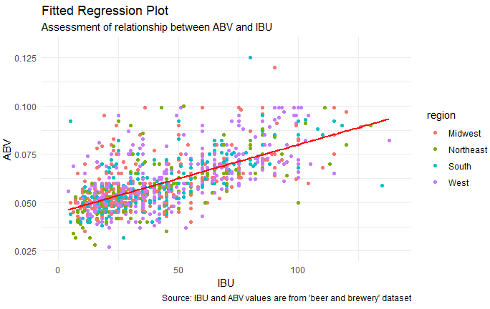
45% of the variation
in ABV is explained
by the amount of IBU
Significant
Relationship
As IBU increases,
So does ABV.
Notes:
The graph provides the result of the linear relationship between Bitterness and alcohol volume of beers.
The red line indicates a positive linear relationship, or in other words, as bitterness increases, there is evidence to suggest ABV also increases.
The top right banner summarizes the correlation output where 45% of the variation
in ABV is explained
by the amount of IBU

Slide 9
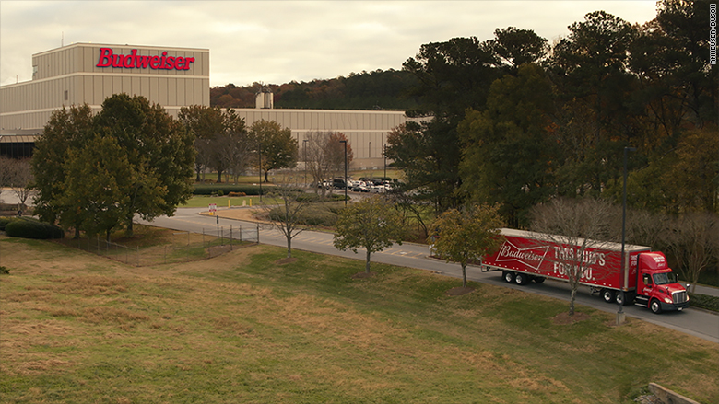
Conclusion
For additional details on the dataset and findings refer https://github.com/naivelogic/MSDS-6306-Case-Study-01-Budweiser
Notes:
https://www.bing.com/th?id=OIP.UbW1LAcy8QEVo8lckEaXMwHaEK&pid=Api&rs=1&p=0
To conclude,
American related syle beers are high produced, with further research, we can discover the profitability of each style
For production consideration, we evaluated that we move east to west the median average of alcohol volume and bitterness increases
Finally, there is substantial evidence to suggest positoive relationship between alcohol volume and bitterness.
I have included additional slide for your teams analysis in the appendix and a link to the Report GitHub page for additional assessment of the results in a reproducable fashion.

Slide 10
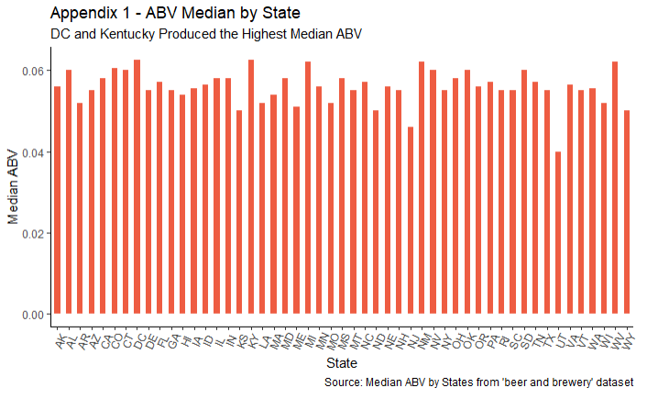

Slide 11
